Slide 1
Targeting the Soleus and Quadriceps
Muscles Using Powered Robotic Rehabilitation Devices and Neuromuscular Control
Evan Tulsky

Slide 2
Motivation
Individuals with neurological disorders (NDs) experience partial or total loss of motor and sensory function
Significantly impacts an individual’s independence and quality of life
Around 800,000 people in the U.S. have a stroke each year
Notes:
Individuals with neurological disorders (NDs) experience partial or total loss of motor and sensory function
Significantly impacts an individual’s independence and quality of life
Around 800,000 people in the U.S. have a stroke each year
Rehabilitation strategies can enhance effectiveness of recovery and training

Slide 3

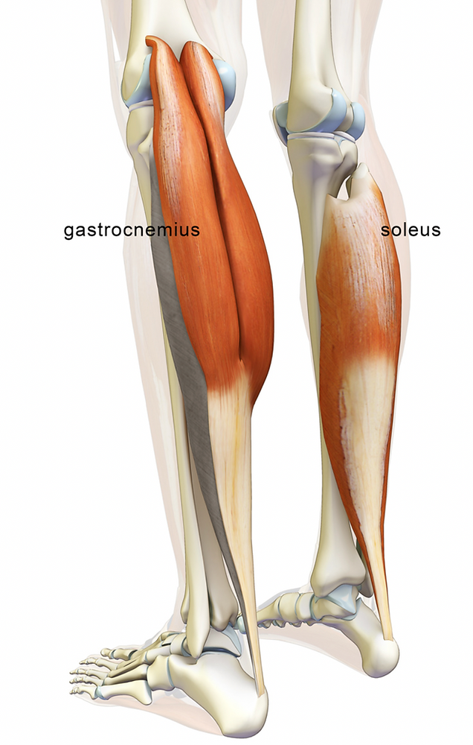
Gait Training for Soleus Muscle Rehabilitation
Notes:
EMG is a data sensing tool that measures the voltage difference of the recruitment of a motor unit action potential (m.u.a.p) between two electrodes

Slide 4
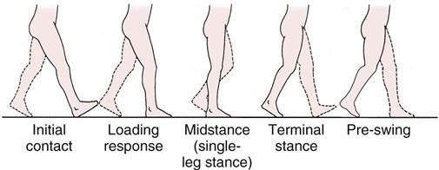
Soleus Muscle Rehabilitation
In the mid-late stance phase, soleus muscle triggers propulsion and force generation
With stroke, the soleus muscle activation patterns and propulsion are diminished
Notes:
With stroke, the soleus muscle is not loaded correctly, which diminishes paretic plantar flexor activity and limits gait speed. Targeting the soleus muscle during walking can facilitate training and promote lasting gait benefits [18] (e.g., natural soleus activity and increased propulsion).

Slide 5
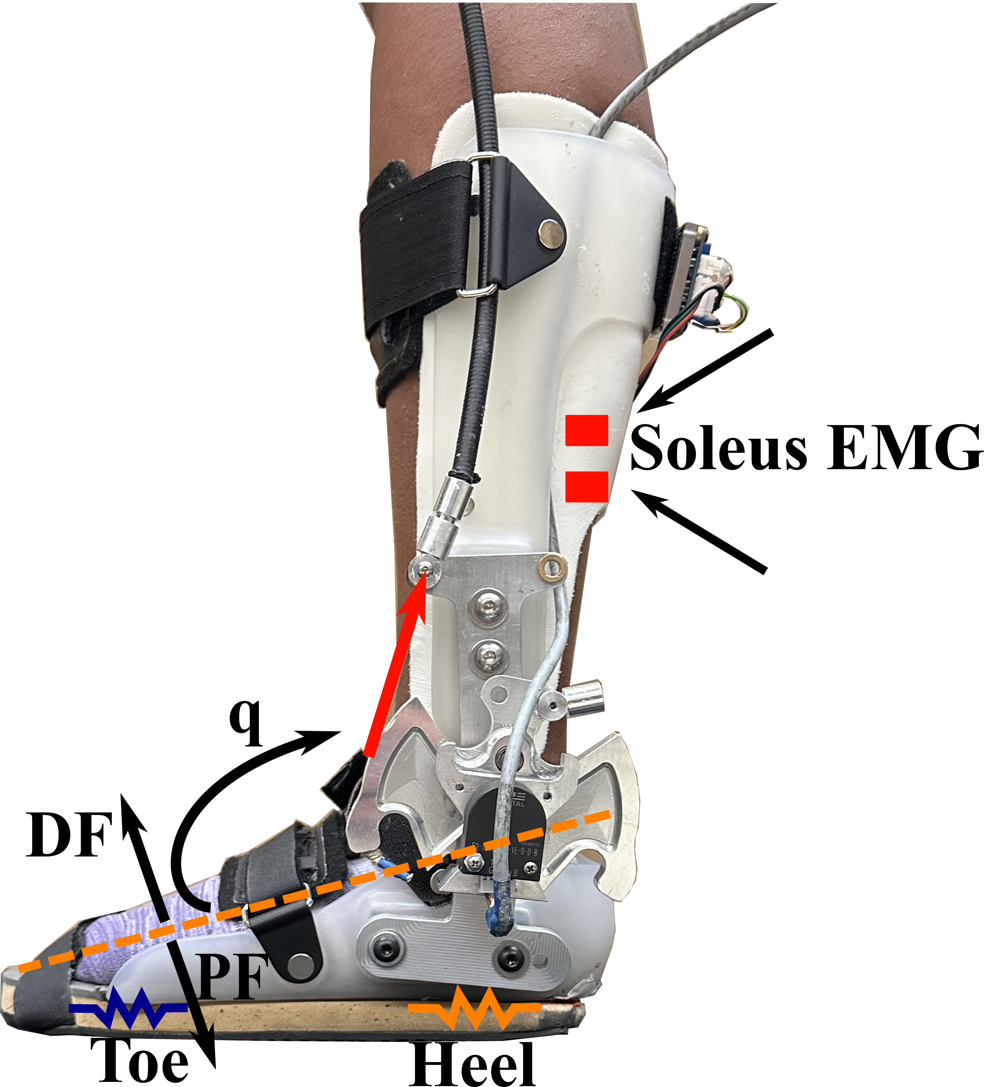
Extremum Seeking Control for Ankle Perturbation Trajectory Generation
Tulsky, ER, Rubino, N, Carter, J, Thompson, A, Duenas, V. (Under Review). “Extremum Seeking Control of a Robotic Ankle-Foot Orthosis Targeting the Soleus Muscle Activation During Walking”, CCTA, Newcastle, England.

Slide 6
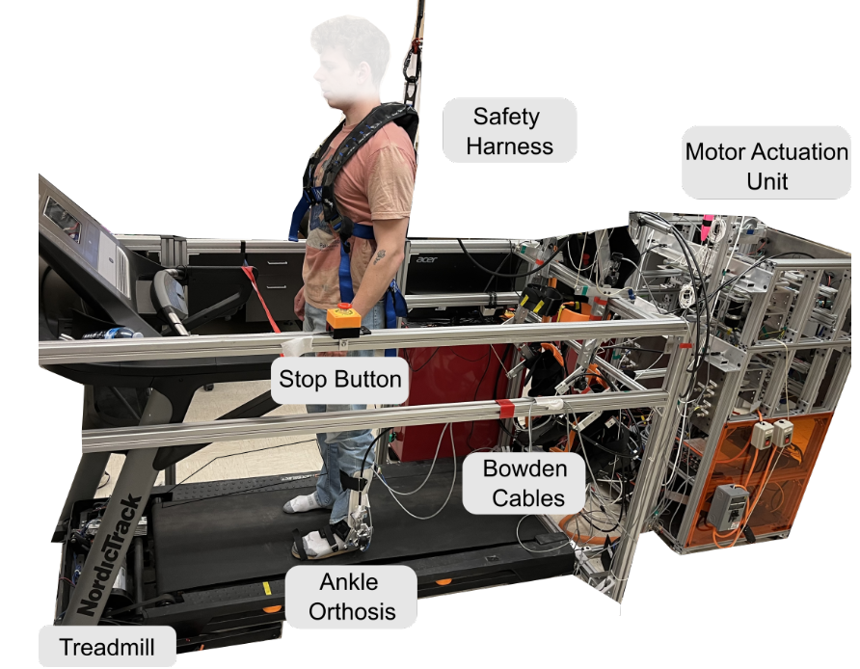
Ankle Orthosis Setup
Notes:
EMG is a data sensing tool that measures the voltage difference of the recruitment of a motor unit action potential (m.u.a.p) between two electrodes

Slide 7
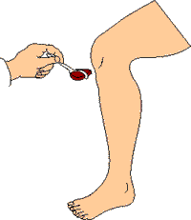
Perturbation
Applied force on muscle that elicits response

Slide 8
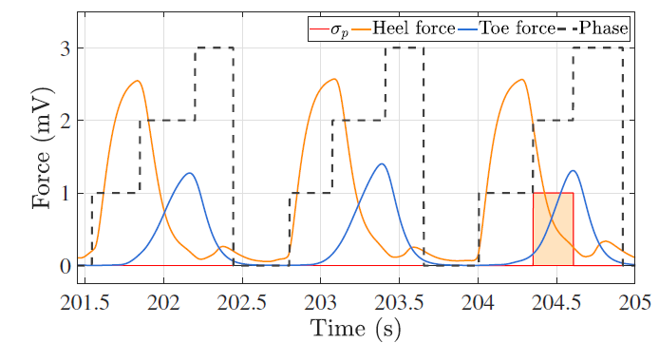
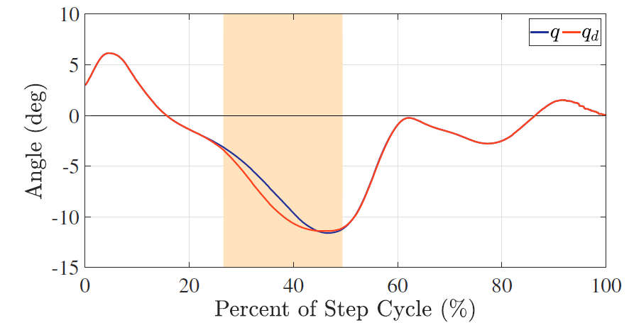
Gait Phase Detection
Notes:
gait phase detection algorithm is implemented to compute the switching signal $\sigma_p$ using heel and toe ground reaction forces to determine the heel strike and define the perturbation phase. The phases transition between $phase = 0$ (swing), $phase = 1$ (heel strike and early stance), $phase = 2$ (perturbation region in mid-late stance), and $phase = 3$ (stop perturbation in terminal stance), which ensures the perturbation is halted prior to the start of the swing phase. The perturbation region is denoted by $\sigma_p = 1$ depicted by the shaded orange region in the third step. The ankle angular velocity $\dot{q}$ is used to determine when to stop the perturbation phase. The perturbation phase ends when the ankle joint reaches peak dorsiflexion such that $\dot{q}$ becomes $\dot{q}>0$.

Slide 9
Extremum Seeking Control
Leverages an unknown input-output map
Adaptive method to characterize the unknown ankle angle to soleus muscle activation map
Notes:
One of the main advantages of ESC is that knowledge of the cost function and the input-output map do not need to be known
it is unknown how to determine the optimal perturbation magnitude during walking to accommodate for the specific characteristics of the human. Hence, an online adaptive strategy is well-motivated to compute the perturbation magnitude based on the muscle responses during walking
The classical ESC architecture uses a dither signal to inject excitation and explore the neighborhood around a setpoint to find the extremum.

Slide 10
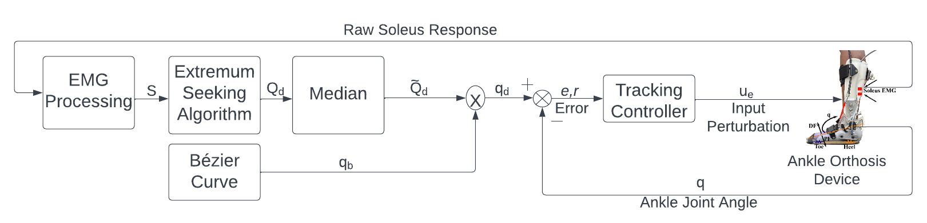
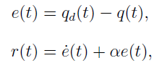
Block Diagram of Ankle Orthosis System

Slide 11
Approach
4 able bodied individuals
360 second walking experiment
Perturbations applied every third walking step
Treadmill walking at a comfortable 1 m/s
Participants instructed to follow metronome
Notes:
180 second pre-trial for ankle joint kinematics and toe and heal ground reaction forces
360 second walking experiment was conducted starting with one-minute with fixed ankle joint perturbations of a constant magnitude of two degrees to acclimate the participants to perturbations and collect soleus muscle activity to initialize the ESC algorithm. After one minute, the ESC algorithm started to adapt the perturbation magnitude for five additional minutes.
Perturbations were applied every three steps such that the participant had resumed normal gait walking after two unperturbed steps (i.e., to prevent habituation to the perturbations). A metronome was used to promote consistent cadence (steps per second) and thus, obtain quasi-cyclical ankle joint trajectories $q$ to ensure steady walking for improving performance of the ESC algorithm.

Slide 12
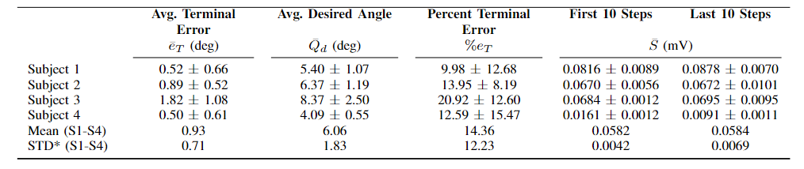
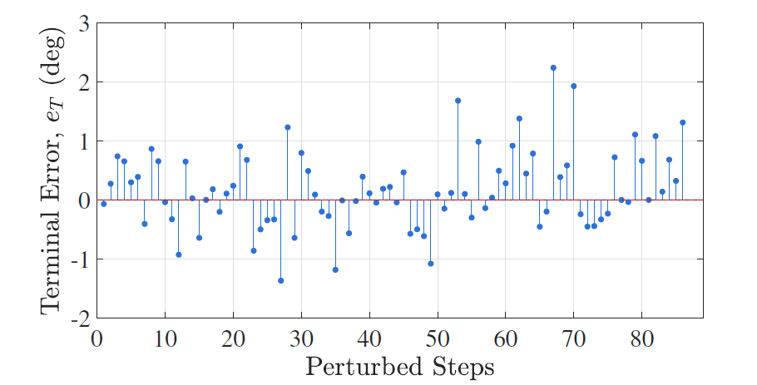
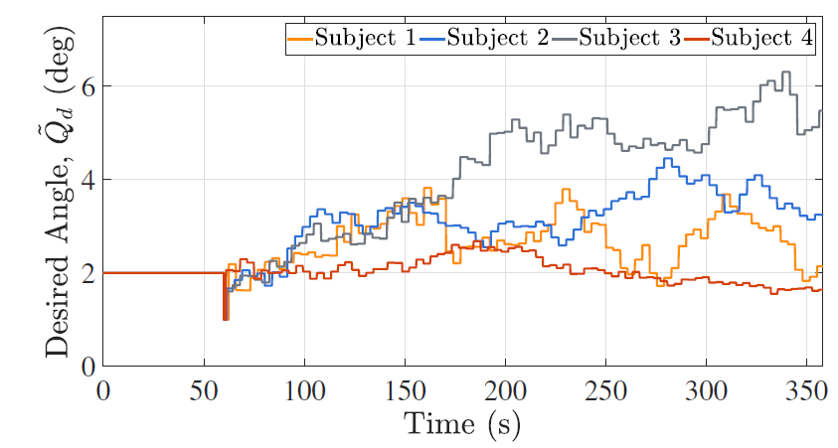
Results

Slide 13
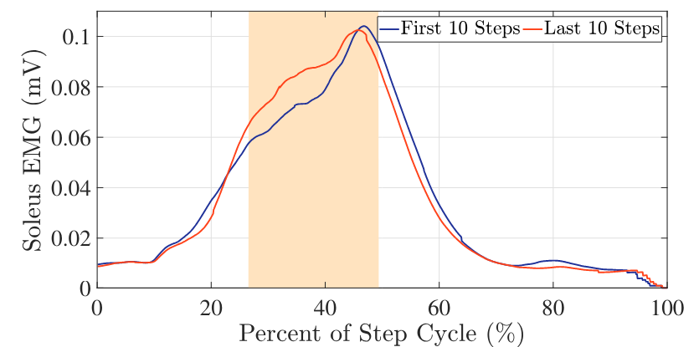
Average Soleus Muscle Response as a Function of the Step Cycle

Slide 14
Conclusions
An ESC algorithm updates ankle perturbations to evoke increments in activity of the soleus muscle during treadmill walking
Suitable tracking performance leveraging the terminal error (error at the peak dorsiflexion angle)
Preliminary evidence supports muscle activity differences between beginning and ending perturbed steps
Future work includes the implementation in stroke survivors during walking

Slide 15
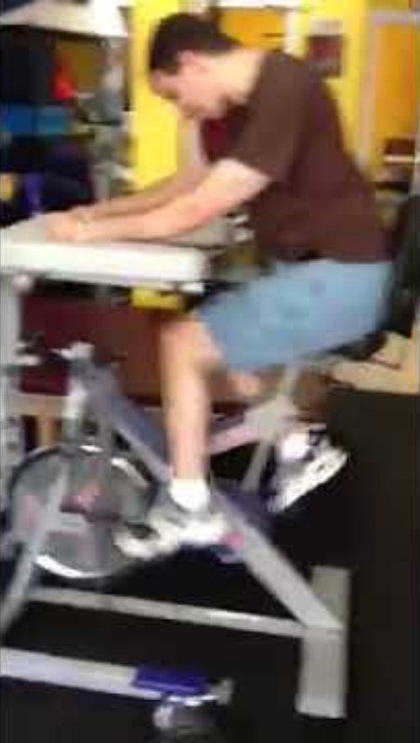
Influence of Vibration Stimuli on the Quadriceps Femoris Muscles During FES-Induced Cycling
Tulsky, ER, Casas, J, Cheng-Hao, C, Brose, S, Duenas, V. (September, 2021). “Influence of Vibration Stimuli Applied on the Quadriceps Femoris Muscles During Functional Electrical Stimulation Induced Cycling”, International Functional Electrical Stimulation Society, Rovinj, Croatia (Online).

Slide 16
Motivation
FES induce controlled muscle contractions and facilitate pedaling a cycle
FES-cycling has restrictions
Muscular fatigue develops more rapidly using FES
Spasticity from SCI individuals limit duration
Explore the impact of mechanical vibration during FES contractions
Notes:
Muscular fatigue develops more rapidly using FES than volitional contraction due to a reverse recruitment order of motor units (i.e., opposite to the size principle) or recruitment of motor units using a nonselective, synchronous and spatially fixed patterns
Functional electrical stimulation (FES) applies a voltage potential to lower-limb muscles to induce controlled muscle contractions and facilitate pedaling a cycle
FES facilitates lower-limb movement and improves muscle mass, muscle strength, bone mineral density, and blood flow
FES-cycling has restrictions
Muscular fatigue develops more rapidly using FES
Spasticity from SCI individuals limit duration
And so, An outstanding challenge for the implementation of FES-powered devices is the need to achieve long-duration rehabilitation sessions to maximize physiological and cardiovascular benefits.

Slide 17
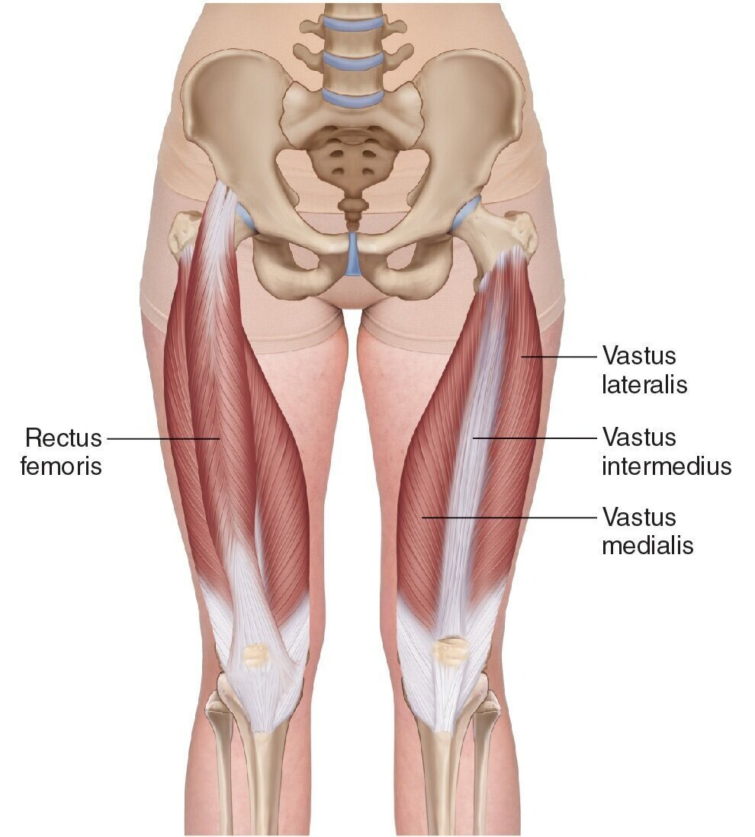
Quadriceps Rehabilitation
Responsible for majority of force in cycling exercise
Contains the largest muscle mass

Slide 18
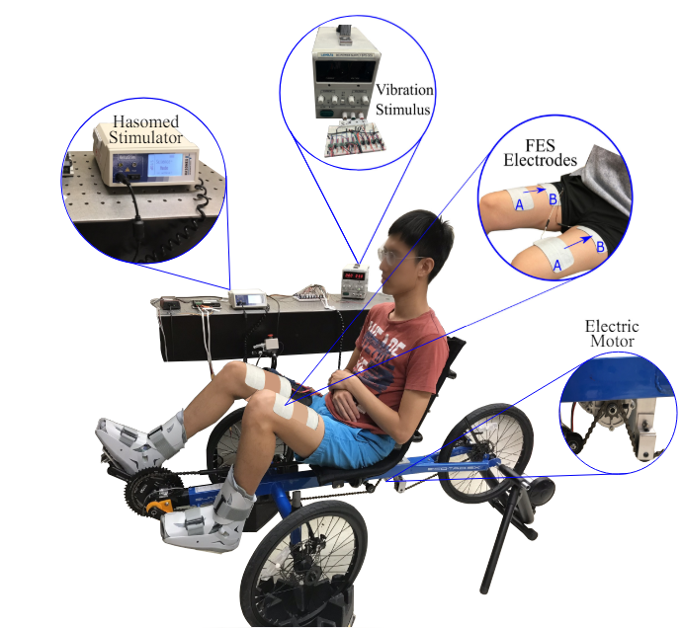
FES-Cycling Setup
Notes:
Four 3” x 5” bipolar surface FES Electrodes placed over the distal-medial and proximal-lateral portions of the quadriceps muscle group

Slide 19
Approach
4 able bodied individuals
Two trials of FES-cycling experiments at 65 rpm cadence for 180 seconds
Without vibratory stimuli
With vibratory stimuli on quadricep
Notes:
COUNTERBALANCED THE ORDER OF STIMULI INTRODUCED
$$τ_{active}=τ−τ_{passive}$$

Slide 20
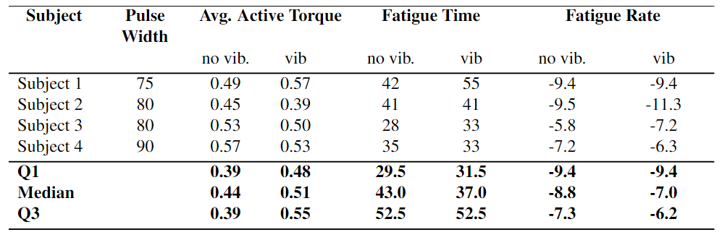
Results
For sample fatigue rate for all participants was 5.23% greater for trials with vibration stimuli

Slide 21
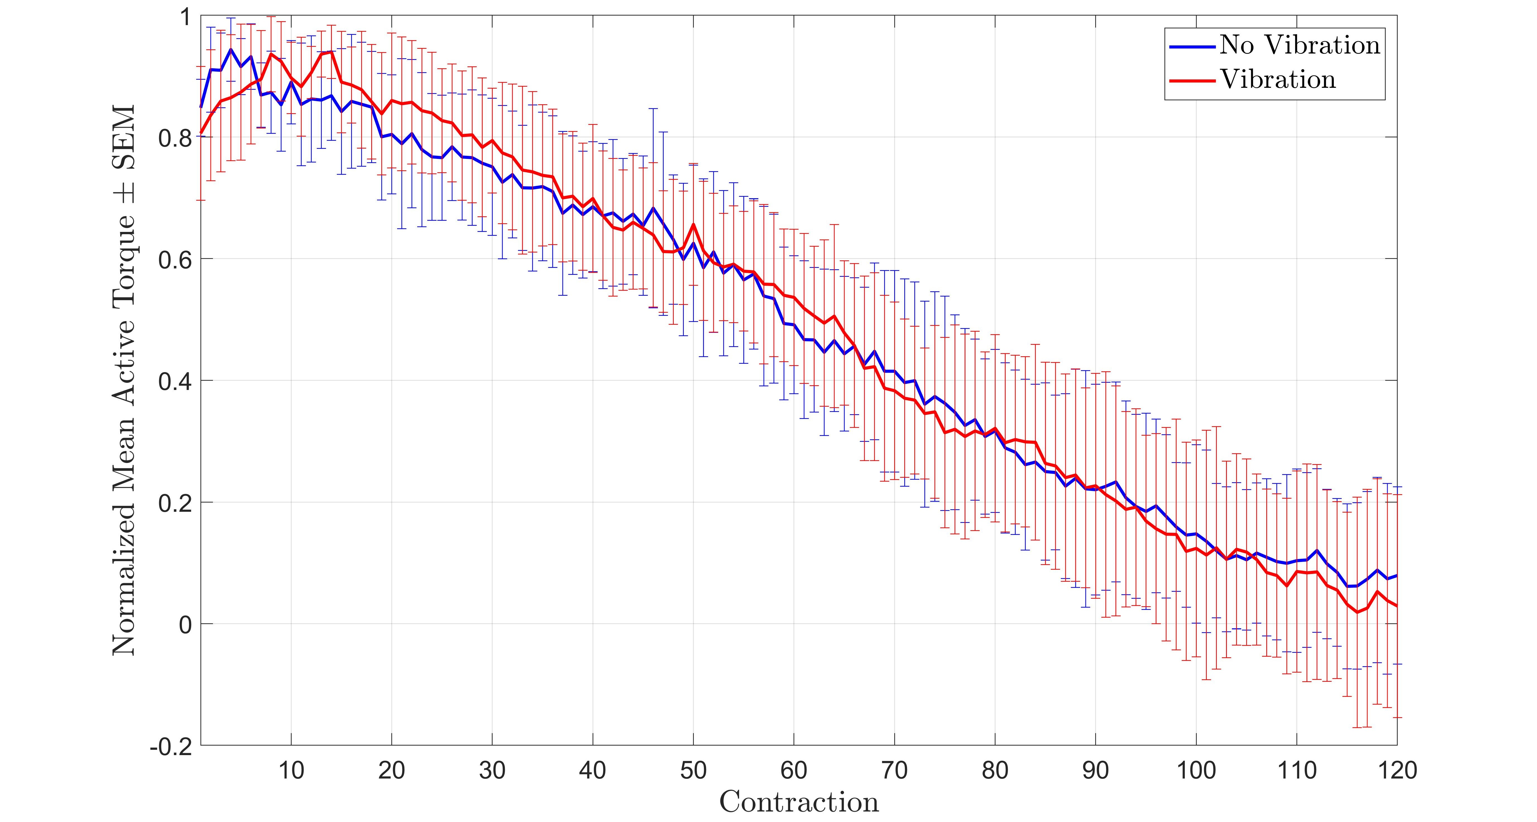
Mean Active Torque for All Participants Over Number of Contractions

Slide 22
Conclusions
Preliminary study on FES-cycling with vibrational stimuli
Future Work
Recruit more participants
Study people with spinal cord injuries
Further investigate optimal vibration patterns, vibrational frequency, and number of vibrational motors on the muscles.

Slide 23


Evan Tulsky Presenter ertulsky@syr.edu
Dr. Victor H. Duenas Supervisor

Slide 24
Questions and Discussion

